Slide 1
주간 연구 보고
Project: LLM-RAG Based Digital Human Counseling System (Nova)
Subject: AI Academic Success & Wellbeing Companion for Undergraduate Students
이름: Meshack Cheboi
보고일: (2026-04-08)
Prof. Kim — ICLAB

Slide 2
01
Summary
Date: 2026-04-08
Progress Overview
Responses are generated using a LoRA fine-tuned Meta Llama 3.2 3B Instruct model integrated with a Retrieval-Augmented Generation (RAG) pipeline.
Counseling responses are grounded using a local semantic knowledge base rather than relying solely on the language model.
Conversation history, emotion trends, and user sessions are persistently stored.
Only the Digital Human Avatar integration remains to complete the original project architecture.
Core functionality proposed in the original project has been successfully implemented.
Complete end-to-end conversational AI pipeline is operational.
Supports both English and Korean interactions.
Supports both text and voice conversations.

Slide 3
02
Overview
Completed Components
Architecture Component | Status | Exact Models / Technologies Used
User Interface | Complete | React (Web), bilingual English/Korean interface
Core LLM | Complete | Meta Llama 3.2 3B Instruct, LoRA Fine-tuned (nova-counseling), served locally via Ollama
Fine-tuning Datasets | Complete | CounselChat, ESConv, MentalChat16K, Amod Mental Health Counseling Conversations
Prompt Engineering | Complete | Persona-based prompting, dialogue management, context-aware prompt construction
Retrieval-Augmented Generation | Complete | Generator: Meta Llama 3.2 3B Instruct (LoRA Fine-tuned) Embedding Model: nomic-embed-text (Ollama) Vector Database: ChromaDB Retrieval: Top-3 semantic similarity search
Knowledge Base | Complete | Stress & Psychology, Career & Employment, University Information
Speech-to-Text (STT) | Complete | faster-whisper using the Whisper Base model (offline CPU inference)
,

Slide 4
03
Continuation
Completed Components
Architecture Component | Status | Exact Models / Technologies Used
Text-to-Speech (TTS) | Complete | pyttsx3 using the Windows SAPI5 speech engine
Emotion Detection | Complete | Rule-based emotion inference engine
Intent Detection | Complete | Rule-based intent classifier
Stress-Type Classification | Complete | Rule-based stress inference
Crisis Detection | Complete | Rule-based bilingual crisis detection with dedicated safety response
Backend API | Complete | FastAPI
Database | Complete | SQLite (SQLAlchemy ORM)
Conversation Logging | Complete | Persistent conversation history and session logging
Multi-session Trend Tracking | Complete | Emotion trend analysis across previous counseling sessions
Digital Human Avatar | Pending | Avatar rendering, facial expressions, lip synchronization, gesture animation
,

Slide 5
04
Overall System Workflow
Retrieved knowledge is combined with:
Conversation history
Persona prompt
Emotion state
Trend information
Meta Llama 3.2 3B Instruct (LoRA Fine-tuned) generates the counseling response.
Response is converted into speech using pyttsx3 (Windows SAPI5).
Conversation history and emotional state are stored in the SQLite database.
Emotion trends are updated across user sessions.
Current interface visualizes emotional state using an animated orb.
User enters text or voice input.
Voice input is transcribed using faster-whisper (Whisper Base).
User message is analyzed for:
Intent
Emotion
Stress type
Crisis risk
Query is embedded using nomic-embed-text.
ChromaDB retrieves the most relevant counseling knowledge (Top-3 semantic search).
System Pipeline
User Input → Speech Processing → User Inference → RAG Knowledge Retrieval → Fine-tuned Llama 3.2 → Response Generation → Voice/Chat Output → Digital Human Avatar

Slide 6
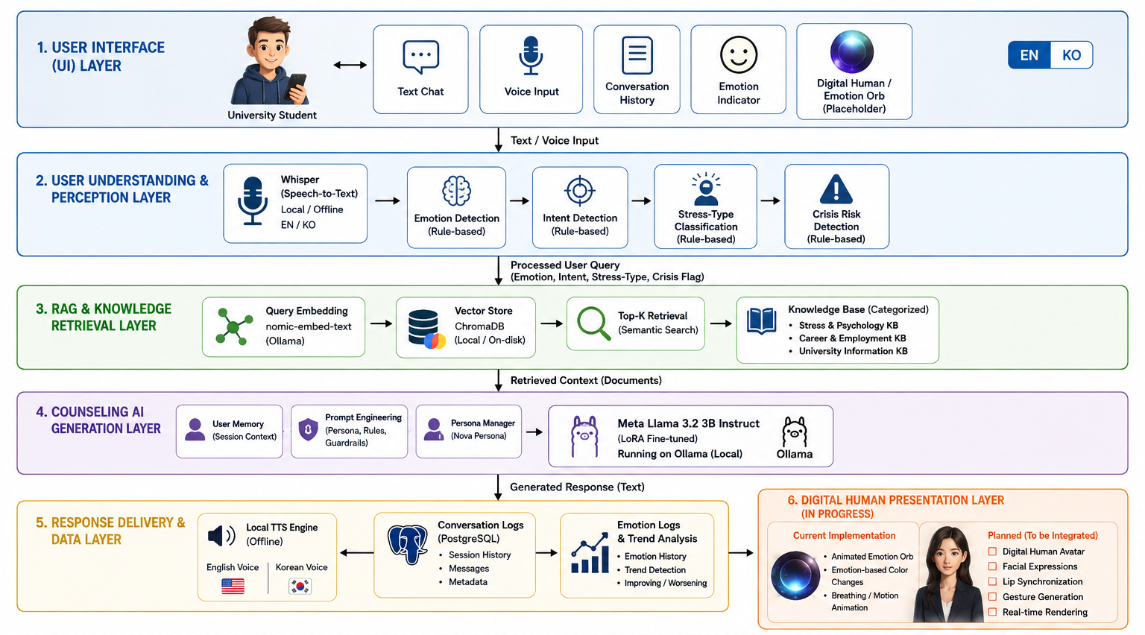
05
System Architecture
Figure 1. LLM-RAG Based Digital Human Counseling System Architecture

Slide 7
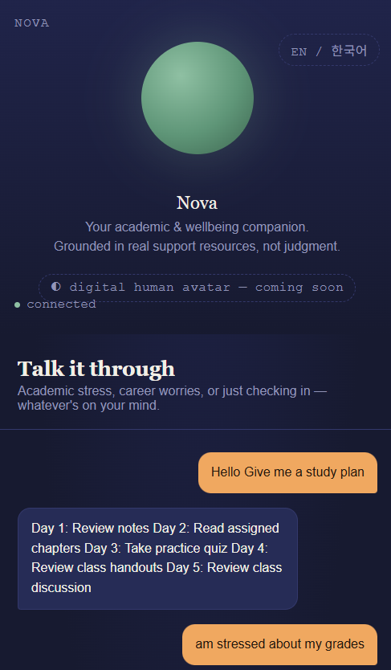
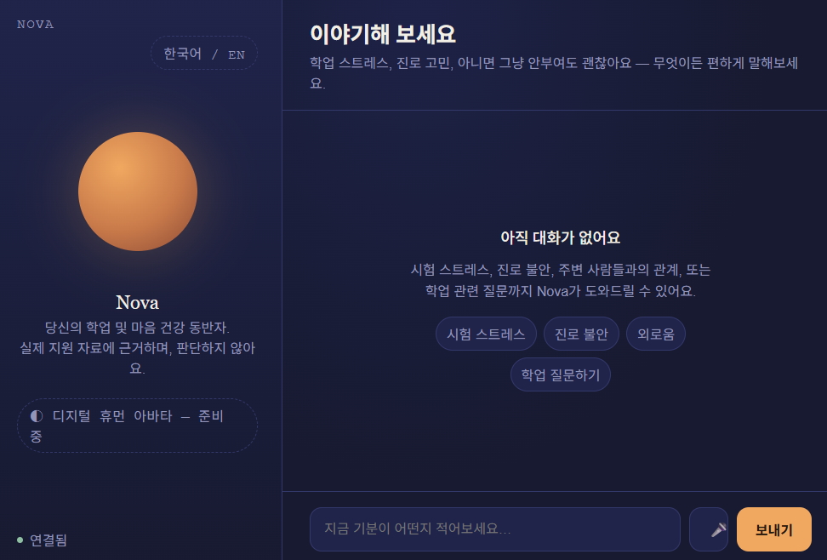
06
User Interface

Slide 8
07
Remaining Tasks
Select the digital human avatar framework.
Integrate avatar rendering into the existing React frontend.
Replace the current animated emotion orb with the avatar.
Synchronize lip movement with generated speech audio.
Connect facial expressions to the detected emotional state.
Configure gesture animations.
Optimize real-time avatar rendering.
Perform complete end-to-end integration testing.

Slide 9
08
Conclusion
The proposed LLM-RAG Digital Human Counseling System has been successfully implemented as a fully operational counseling platform.
Core AI components including the LoRA fine-tuned Meta Llama 3.2 3B Instruct model, nomic-embed-text embeddings, ChromaDB semantic retrieval, faster-whisper speech recognition, pyttsx3 speech synthesis, emotion inference, intent detection, conversation management, and persistent session tracking have been completed and integrated.
The current system provides end-to-end bilingual counseling through text and voice while maintaining conversational context and retrieval-grounded responses.
The only remaining task from the original project proposal is the Digital Human Avatar integration, which consists of avatar rendering, lip synchronization, facial expression generation, and gesture animation. Once this visual layer is connected to the existing speech and emotion pipelines, the project will fully match the architecture proposed at the beginning of the project.

Slide 10
Thank You

